Slide 1

SMTP Lab using Python:
Udita Sarkar Chandrabindu
Id-2102006 Ref-10133
Course Code-CCE 314
Semester- 5h semster
Notes:
1

Slide 2

Project Overview: Email System
The core objective is to build a functional SMTP email client and server. The client composes and sends emails, while the server processes and delivers them to the recipient's mailbox. This hands-on experience clarifies the architecture behind everyday email exchanges.
Notes:
2

Slide 3




Sample Workflow: From Send to Inbox
Server Activation
Begin by running the SMTP server script, which then awaits incoming email messages.
Client Sends Email
The client script is executed, providing server details, sender, recipients, subject, and message body. The email is dispatched.
Server Processing
The server receives the email, processes its contents, and initiates the delivery procedure.
Mailbox Delivery
Finally, the server delivers the email to the recipient's designated mailbox.
Notes:
7

Slide 4
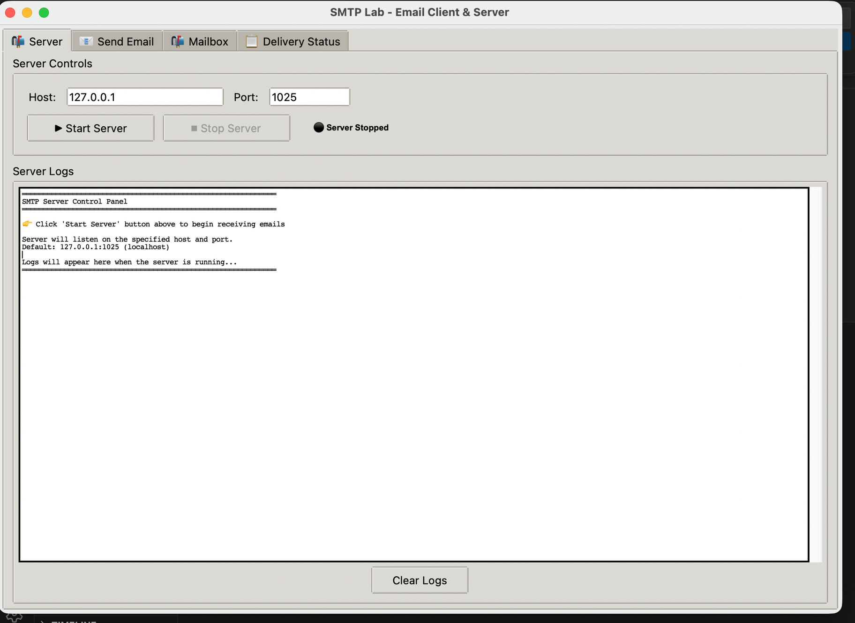
Component 1: The SMTP Server
The server acts as the mail hub, diligently listening for incoming emails from clients. It processes each message, ensuring it reaches its intended destination.
Notes:
4

Slide 5
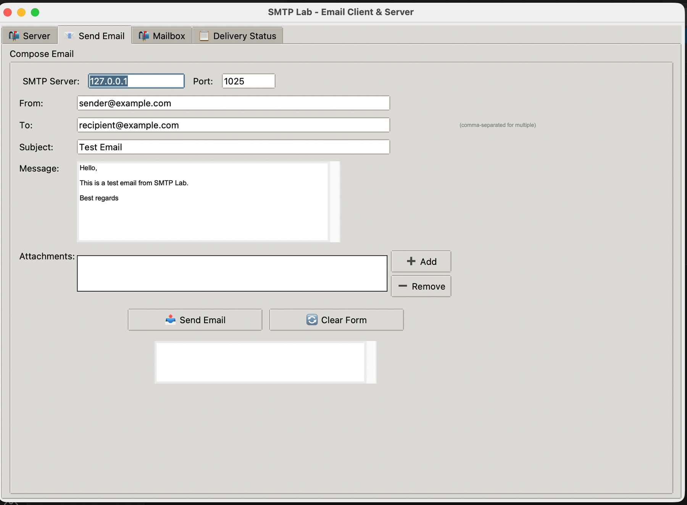


Component 2: The SMTP Client
Composing Emails
The client is your interface for crafting messages, implement features to define the sender, recipient(s), subject, and the email body.
Sending with smtplib
Python's powerful smtplib module will be the primary tool for connecting to the server and transmitting the composed email.
Notes:
3

Slide 6
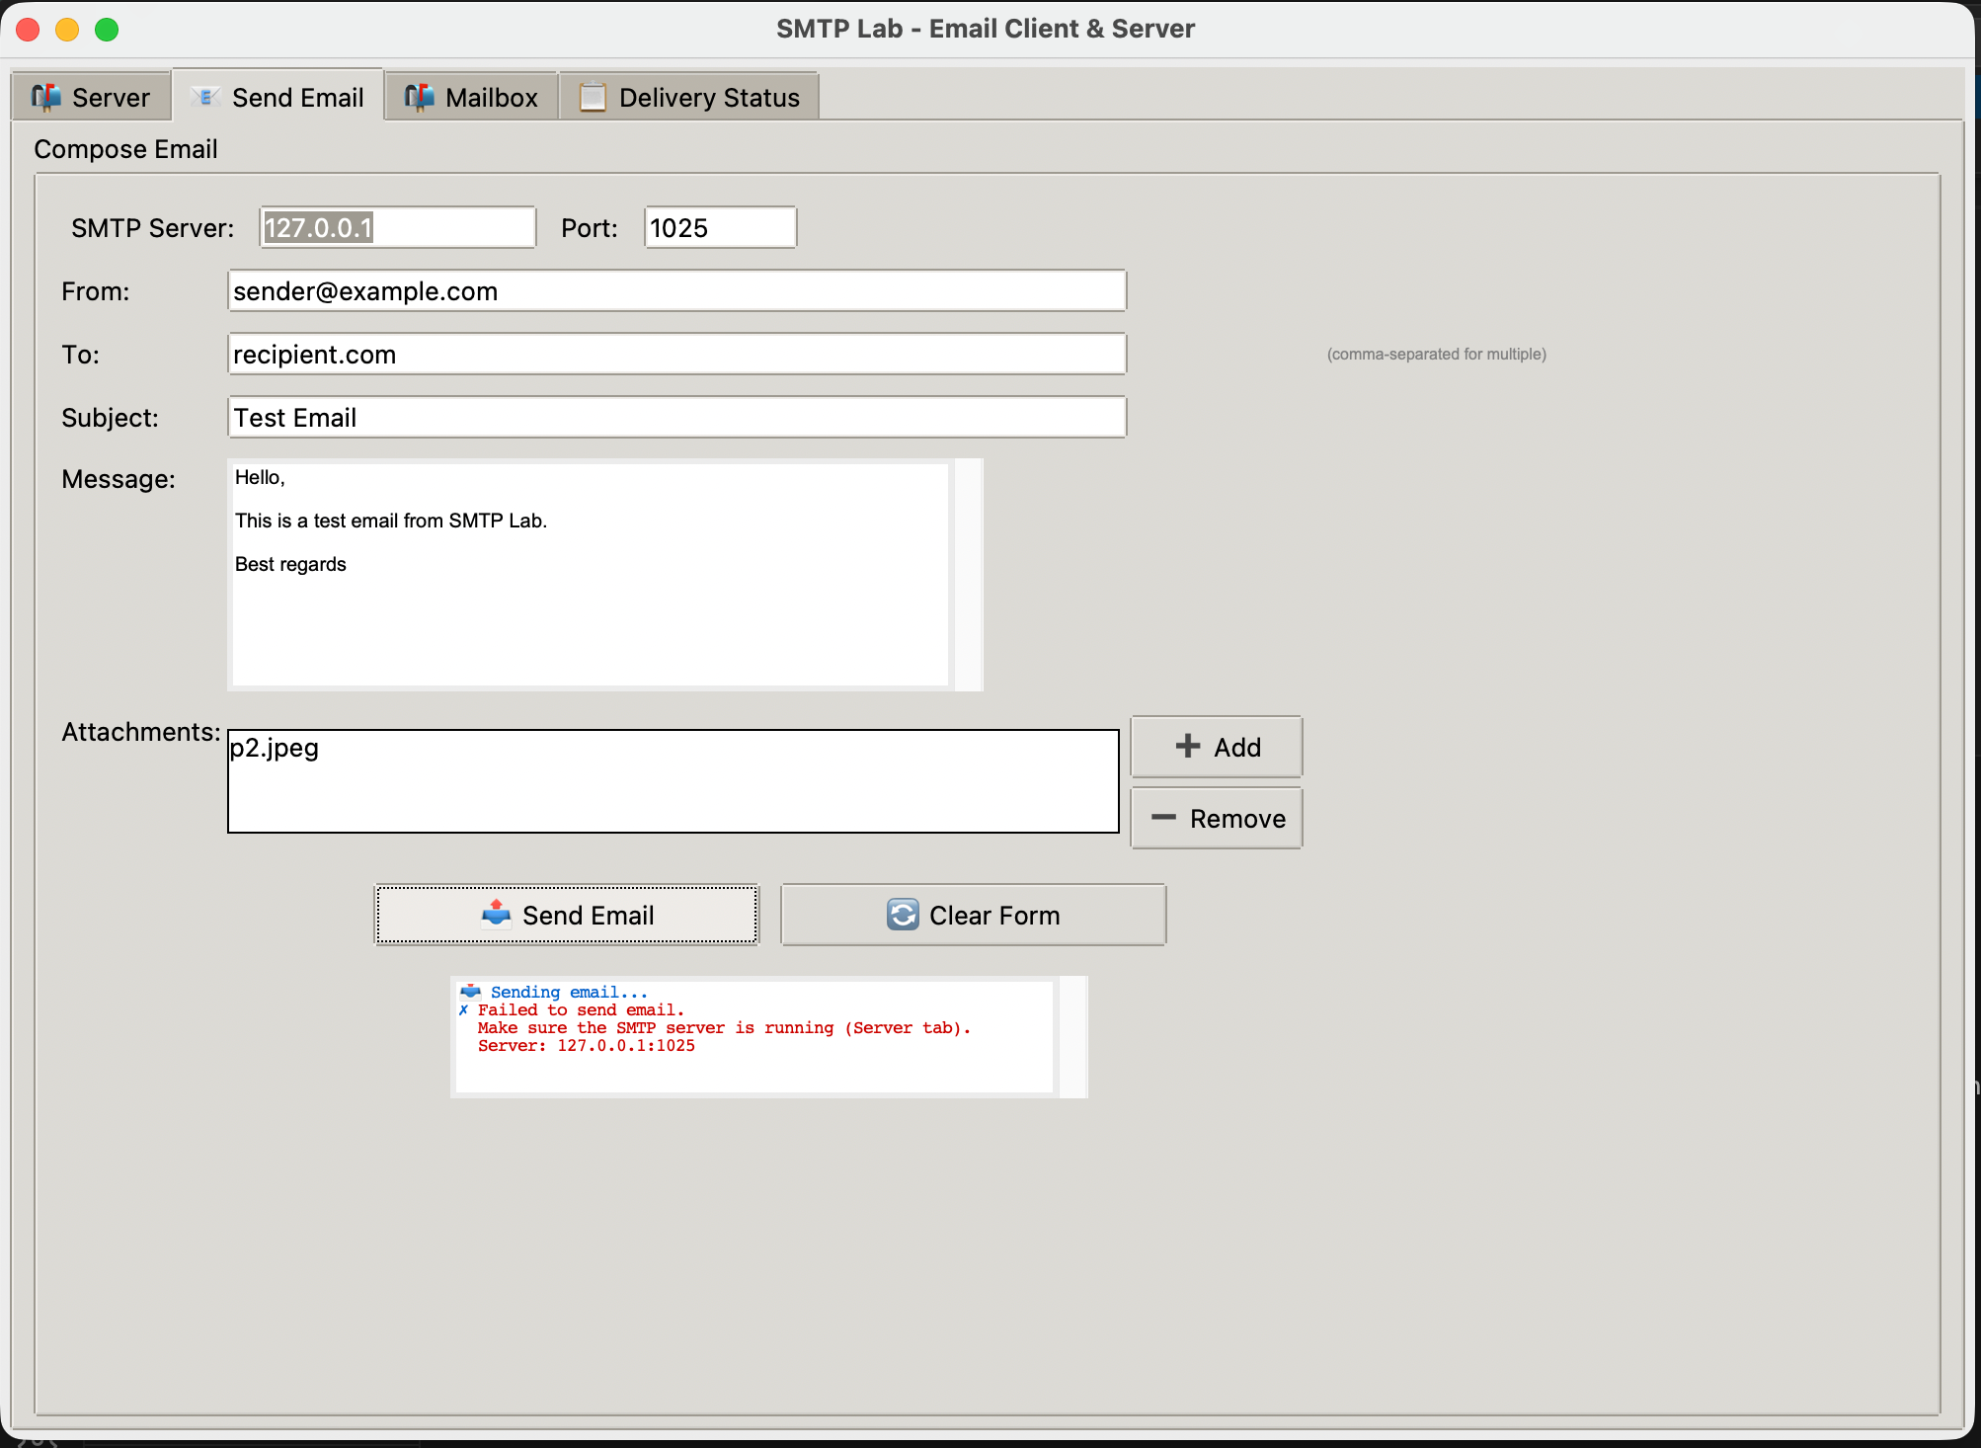


Key Implementation
Email Composition
Allow full control over sender, recipients, subject, and body.
Robust Error Handling
Manage invalid addresses, failed deliveries, and network issues.
Notes:
5

Slide 7
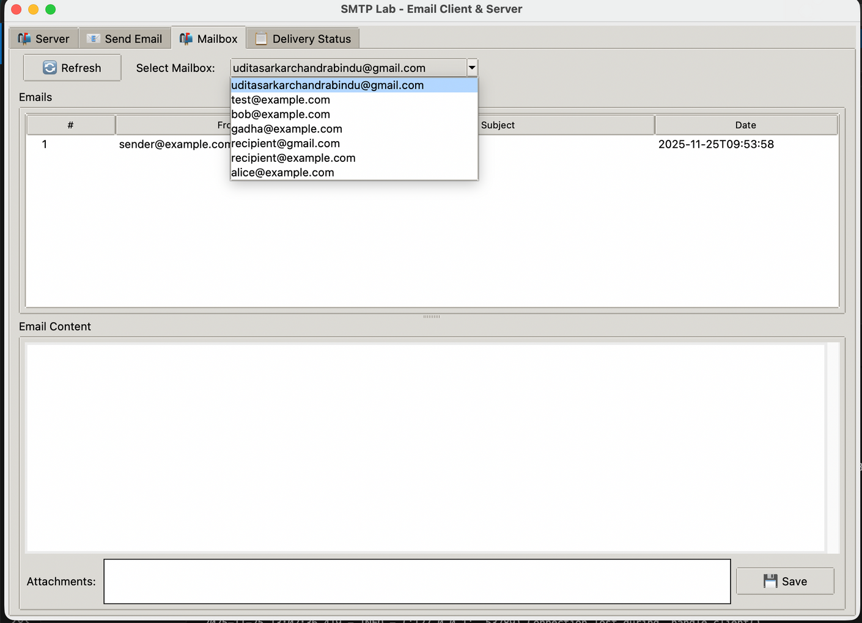
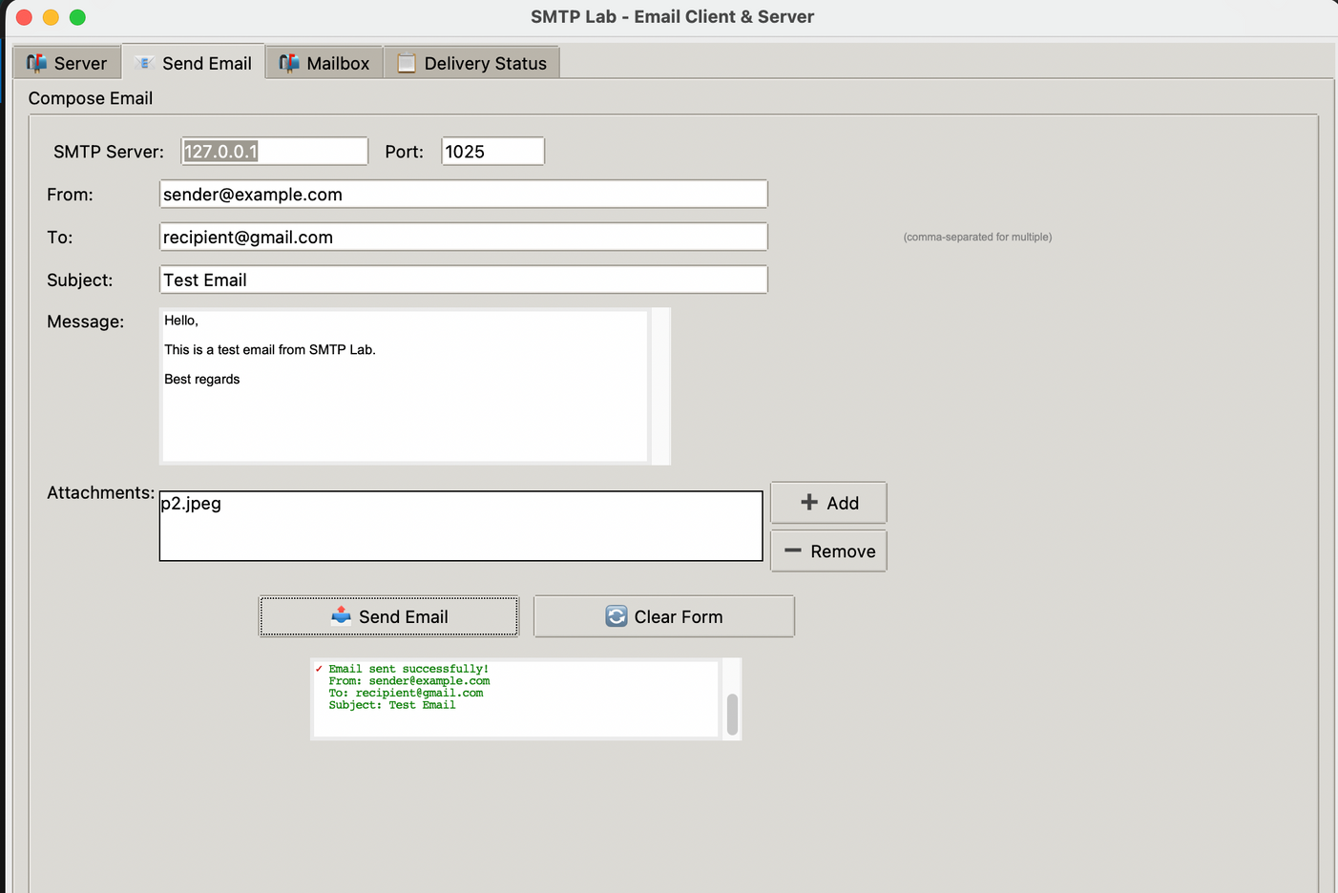
Mail Sent and how it is showing
Notes:
6

Slide 8
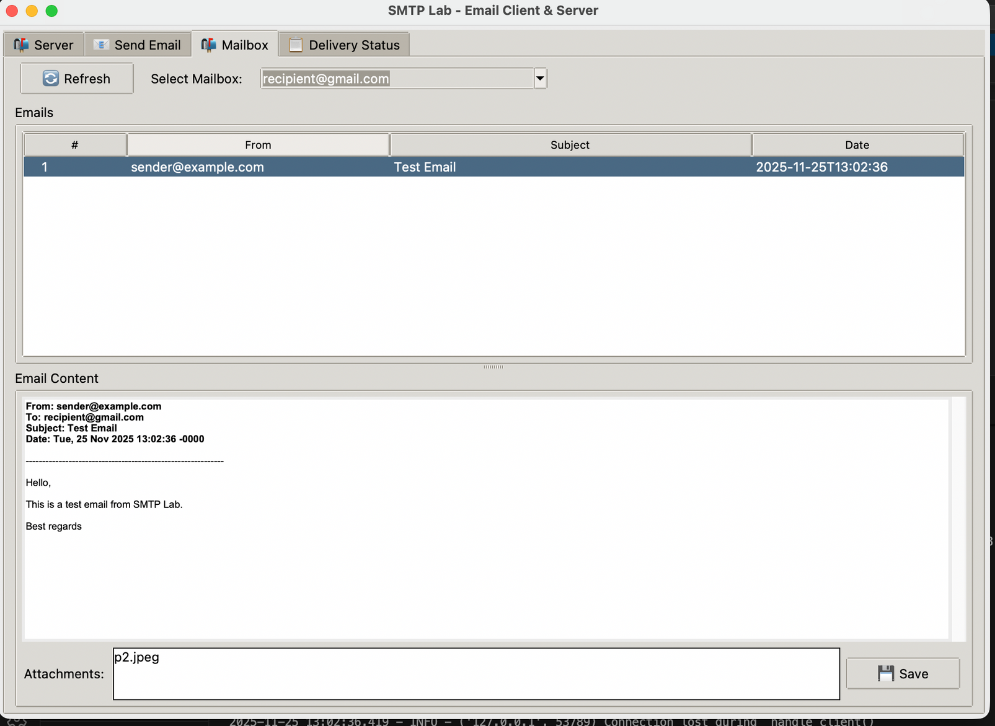


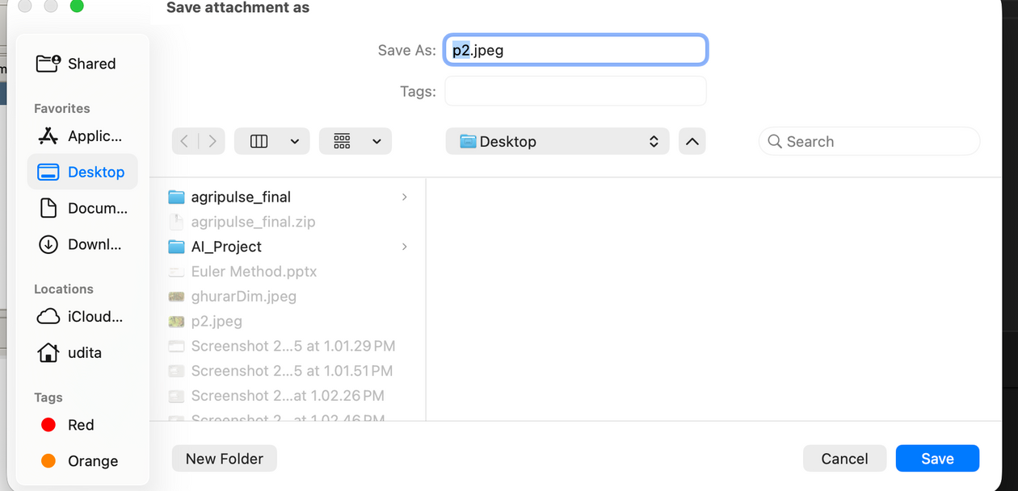
Optional Features
Attachment Support
Extend your client to handle file attachments, expanding email functionality.
Notes:
8

Slide 9
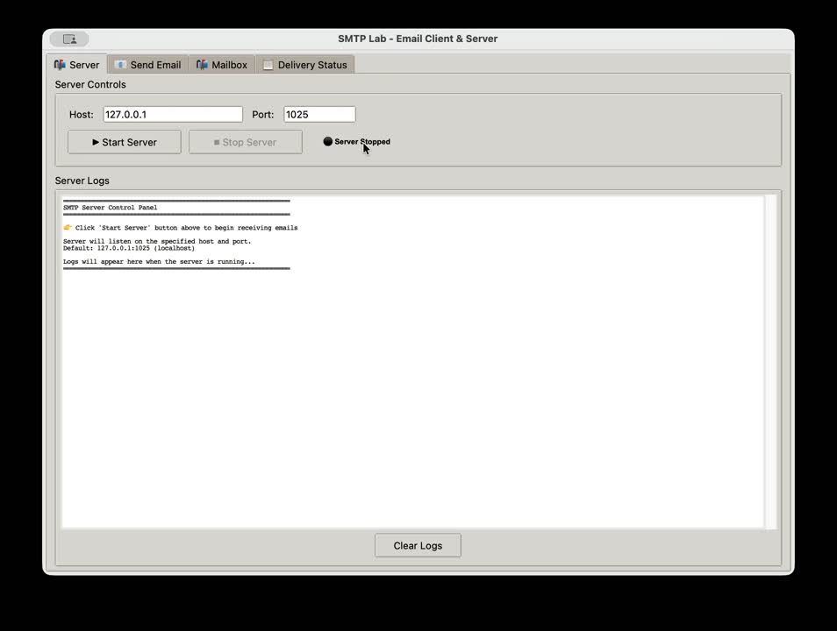
Notes:
9

Slide 10


Thank You
Any Question?
Notes:
10

